Slide 1

Introduction to Processing Amplicon Short Reads in R
Nicholas J. Ollberding, PhD
Associate Professor
Division of Biostatistics and Epidemiology
nicholas.ollberding@cchmc.org

Slide 2

Goals
Provide high-level introduction to processing amplicon data generated via high-throughput sequencing
Present a few differnt approaches
Common processing steps
Work through Ben Callahan’s DADA2 Illumina MiSeq tutorial
https://benjjneb.github.io/dada2/tutorial.html
Work through the Introduction to Phyloseq tutorial

Slide 3
Conceptual Model of a Microbiome Research Project
P1: Project Planning
P2: Sample Collection
P3: Storage and DNA Extraction
P6: Statistical Analysis
P4: Next-Generation Sequencing
P5: Sequence Read Processing
The “analysis” of microbiome data occurs in 2 steps:
Step 1: processing the raw sequence data into form amenable for statistical analysis (i.e. taxa by sample count matrix)
Step 2: correlating microbial features with outcomes of interest

Slide 4
Approaches to Process Amplicon Data
Align sequences to reference database (closed reference assignment)
Limited to mapping reads to only the reference sequences in the database
Shown to have high false positive rate (richness inflated by orders of magnitude) - https://drive5.com/usearch/manual/closed_ref_problems.html
Not recommend expect in very rare situations
Cluster reads based on percent similarity (i.e. 97% OTUs)
Addresses sequencing errors by clustering reads that share > 97% similarity
Best available approach until recently
Cannot resolve differences in sequences with high similarity (>97%)
Cannot think of any situations to recommend < 100% OTUs (expect benchmarking)

Slide 5
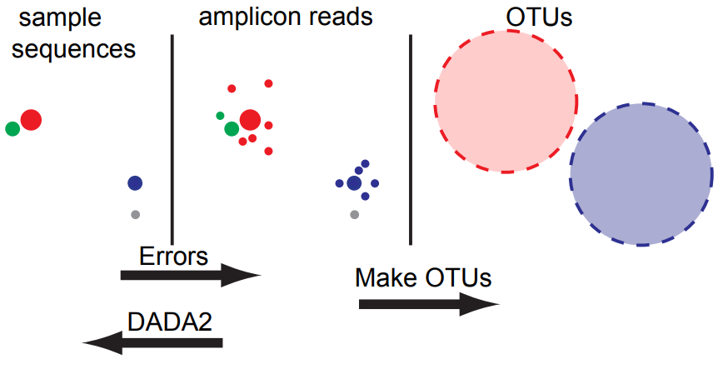
Conceptual Model of OTUs vs. ASVs
https://benjjneb.github.io/dada2/SMBS_DADA2.pdf

Slide 6
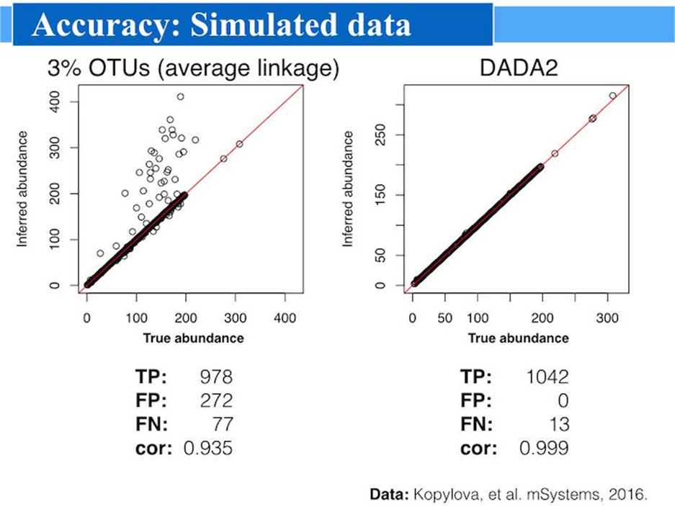
Approaches to Process Amplicon Data
Best current approach is to identify all unique sequences after resolving errors
Goal – report all correct biological sequences in the reads
Errors are resolved by taking into account the number of times a sequence is seen and how different it is from a potential parent
Referred to as “denoising” or “error correction”
Sequence variants known as: ASVs, zOTUs, sOTUs
Pros:
Improved accuracy over 97% OTU clustering
Single nucleotide resolution
Scales well to massively large datasets
https://benjjneb.github.io/dada2/SMBS_DADA2.pdf

Slide 7
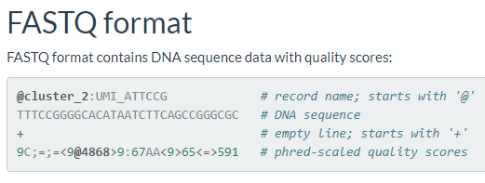
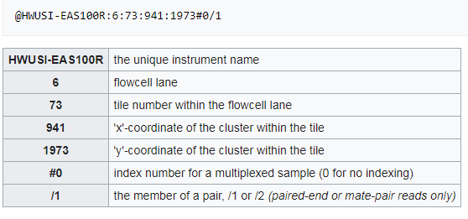
Starting Point: Single or Paired FASTQ files
phred score is Illumina’s estimated accuracy of base call
Amplicon sequencing commonly performed on the Illumina MiSeq or HiSeq
Sequencing center will typically demultiplex files and remove barcodes and adaptors (may want to keep the primers on the reads)
Most pipelines assume single or paired end file for each sample (~5 to 100k reads each)
Most pipelines utilize the phread/quality scores

Slide 8
Common Steps in Amplicon Denoising Pipelines
Filter Low Quality Reads
Alignment and Dereplication
Error Correction
Chimera Removal
Taxonomic Classification
dada2::filterAndTrim
dada2::nwalign and dada2::derepFastq
dada2::learnErrors and dada2::dada
dada2::removeBimeraDenovo
dada2:assignTaxonomy and dada2::addSpecies

Slide 9
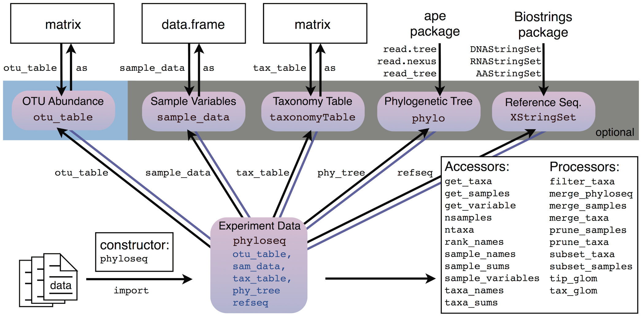
Managing Data Structures with Phyloseq
McMurdie, PLOS ONE, 2013

Slide 10
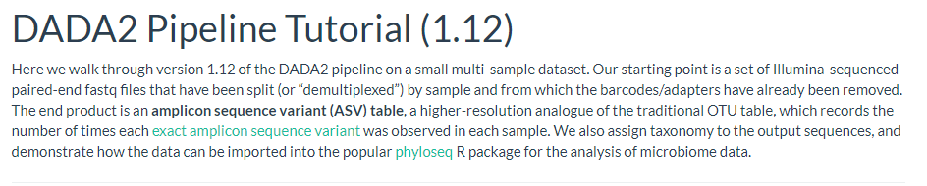
https://benjjneb.github.io/dada2/tutorial.html

Slide 11
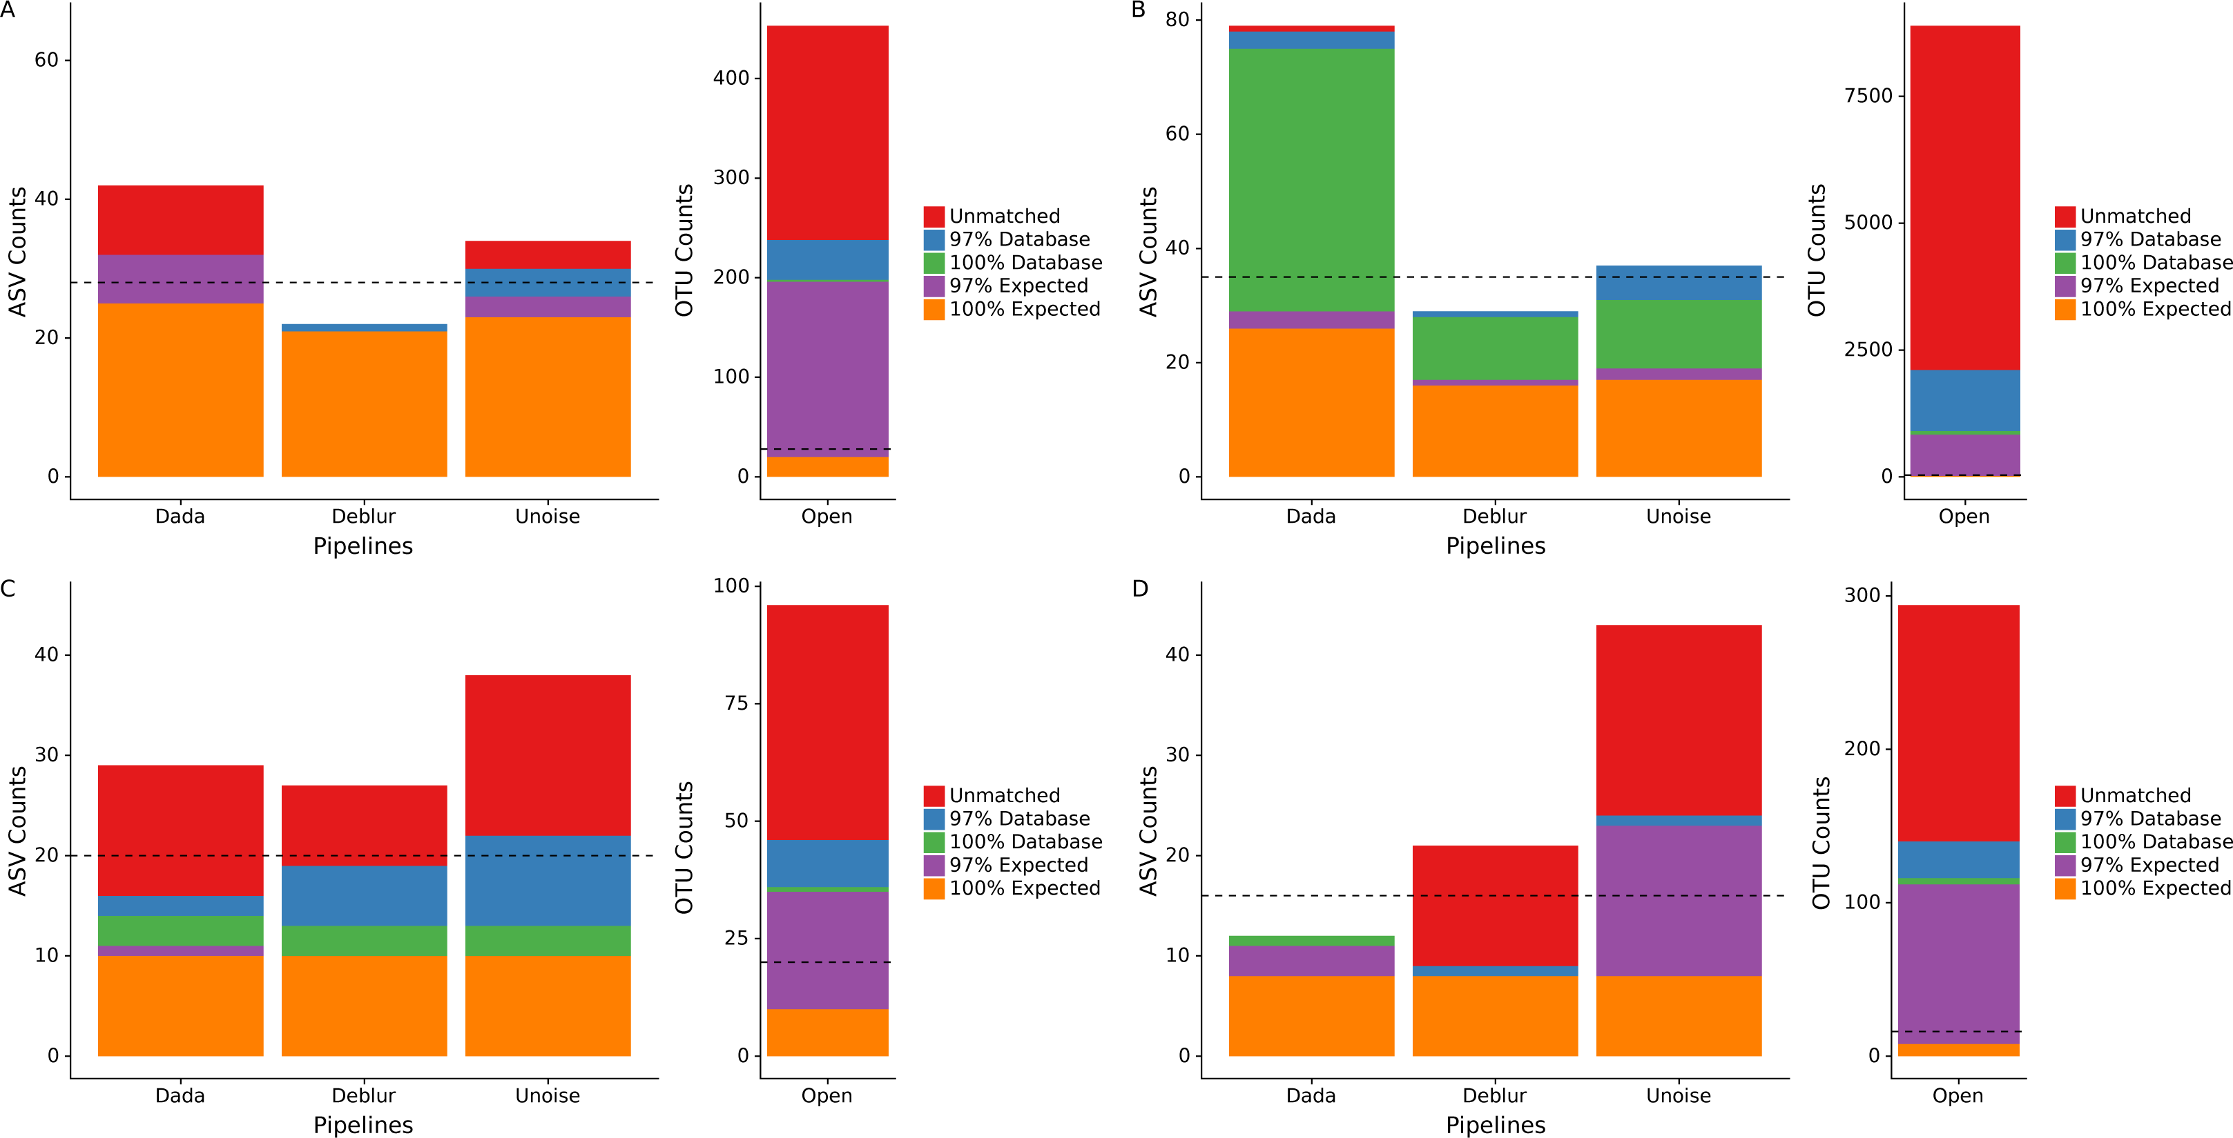
OTU vs. ASV Performance on Mock Communities
Total number of ASVs/OTUs identified by each sequence processing method for four different mock communities. Dashed line is expected number of OTUs. A. HMP (even), B. Mockrobiota Extreme, C. Mockrobiota Fungal ITS1, D. ZymoBIOMICS
Nearing, Peer J, 2018

Slide 12
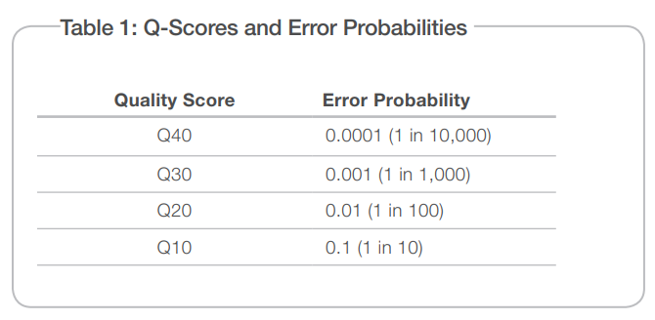
Filtering Low Quality Reads
Low quality sequences containing a higher number of probable errors are typically removed
If not, can (will) inflate false positive rate
Illumina provides a quality score providing the
probability of an error for each base call
Expected number of errors is:
E* = floor(sum(prob. error for each base))
Proper calc. since error prob. is cumulative
https://drive5.com/usearch/manual/exp_errs.html
Typically filter reads with >1 or 2 expected errors or any ambiguous bases
Trim reads where the quality profile crashes to help retain more reads
https://www.illumina.com/documents/products/technotes/technote_understanding_quality_scores.pdf

Slide 13
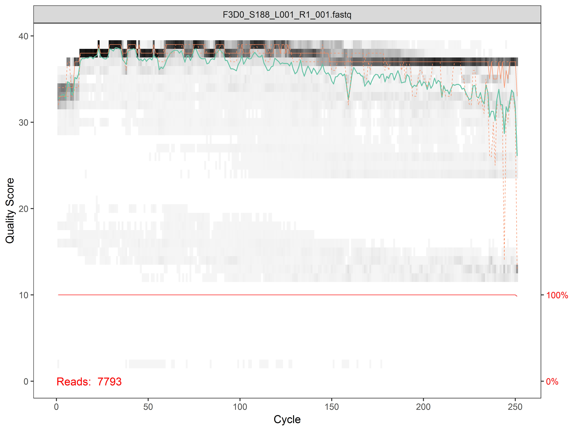
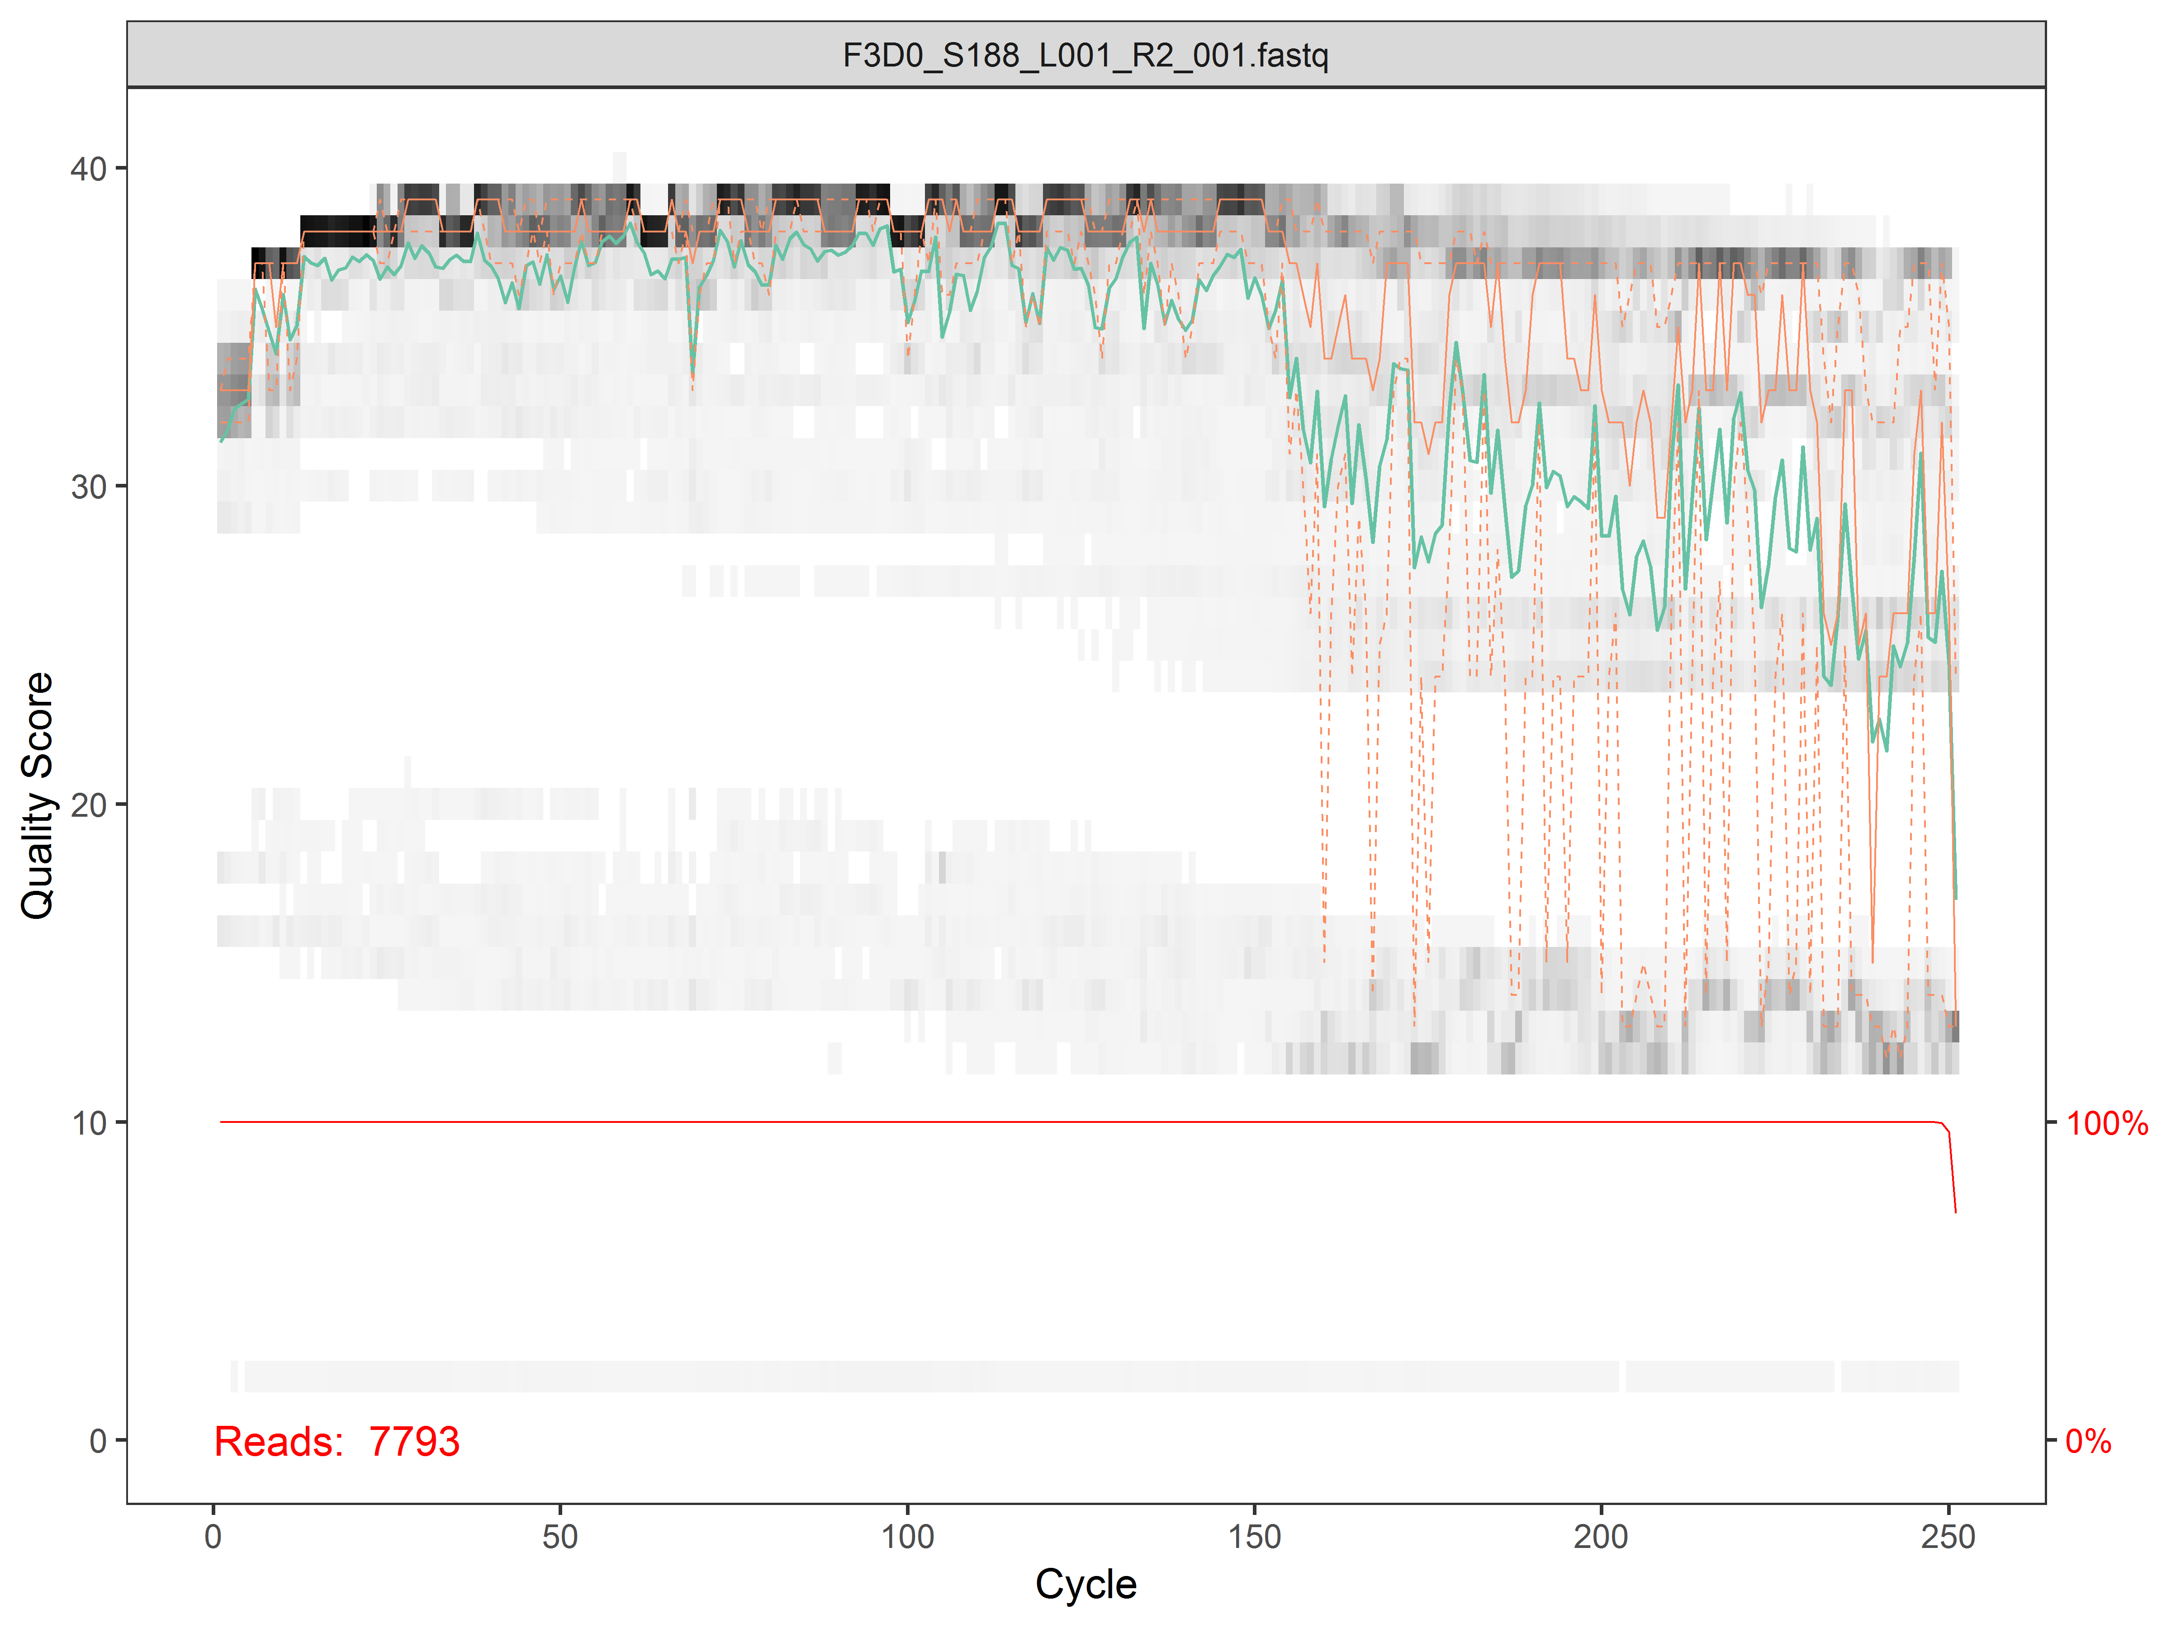
Inspecting Quality Profiles

Slide 14

Alignment and Dereplication
Reads are typically aligned to identify unique sequences accounting for gap or indels
https://en.wikipedia.org/wiki/Needleman%E2%80%93Wunsch_algorithm
Dereplication is performed for computational efficiency
Each unique reads is stored along with a count of the number of times it was observed
Allows one to only do an operation once for each unique read

Slide 15

Error Correction
Denoising algorithms implement error correction using various approaches
However, all exploit information on number of times a sequence is seen and how different it is from its potential parent sequence
DADA2:
Generates an error model based on the observed sequence reads
Error model quantifies rate sequence i is produced from more abundant sequence J as a function of the original and substituting nucleotides and q-score
Errors are assumed to be Poisson distributed: ppois(count_{i}, error prob. x count_{J})
Low p-val. denotes sequence i more abundant than expected under error model
If sequence i has < 10% sequence similarity to J; not aligned and not considered error
Basically, the more times a sequence is seen, and is diff. from parent, ↑ prob. not error
https://www.nature.com/articles/nmeth.3869

Slide 16
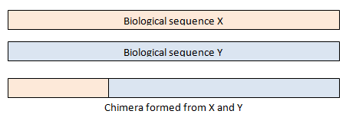
Chimeric Sequences
Chimeras are sequences formed from two (or more) biological sequences joined together
Typically form during PCR when:
Extension of an amplicon is aborted
Serves as a primer in the next PCR cycle
Aborted product anneals to the wrong template
Makes a new sequence from two different template
Typically small fraction of reads are chimeric
However a large fraction of ASVs/OTUs are often chimeric
Tolstoy's Paradox: https://www.drive5.com/usearch/manual/tolstoy.html
https://www.drive5.com/usearch/manual/chimeras.html

Slide 17
Chimera Removal
Chimeric sequences are identified if they can be exactly reconstructed from segments of two more abundant “parent” sequences
Align each sequence to all more abundant sequences
Search for combination of left and right parents
Flag as chimeric if read could have been formed by two parent sequences
Implemented in DADA2 via removeBimeraDenovo
Challenging problem in sequence analysis:
Chimeric sequences are often very similar (or even identical) to true biological sequences
R.C. Edgar (2016), UCHIME2: improved chimera prediction for amplicon sequencing, https://doi.org/10.1101/074252

Slide 18

Taxonomic Classification
Goal: assign taxonomic label to de-novo ASV
Many methods available to do this:
Naïve Bayesian Classier most common approach (Wang, 2007)
Great intro. @ UC Business Analytics: http://uc-r.github.io/naive_bayes
Basically:
Break up query sequence into all possible kmers of size = 8
Calculate the probability a given reference sequence contains a specific kmer
Calculate the probability a query sequence would be in a given reference sequence based on all the kmers it contains (product of all probabilities)
Assign classification based on highest posterior probability (ignore actual prob. estimate)
Randomly select 1/8 of the kmers in the query seq. and then assign taxonomy to get bootstrap estimate for classification
Assignment to the lowest taxonomic rank where bootstrap >= 0.8 common
Notes:
R Edgar’s thoughts on SINTAX vs. RDP: If the posterior probabilities were predictive, then they could be used directly, but in practice it is necessary to abandon the Bayesian approach and use bootstrapping instead to obtain a measure of confidence. I view the Bayesian formulation as an indirect way of obtaining the top 8-mer hit. This is demonstrated in practice by SINTAX, which achieves equally good results by simple 8-mer counting. While it does not achieve a systematic improvement in accuracy, I prefer SINTAX because it is faster, uses less memory, and conceptually simpler.

